Slide 1


Proxenix company internship
GROUP NUMBER 51 DETAILS
Trainee Name
Priyanka (Team Leader)
Poonam Baghel
Purnansha Sahu
Nandani

Slide 2

ZOMATO DATA ANALYSIS

Slide 3

topics
Overview of Zomato Dataset
Technologies Used
Customer Behavior Analysis
Restaurant Performance Analysis
Geospatial Analysis
Predictive Modeling
Conclusion and Recommendations

Slide 4
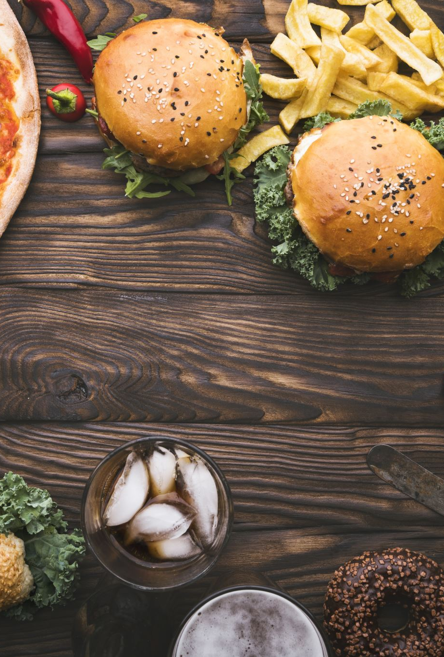
Introduction to Zomato
What is Zomato?
Zomato is a popular Indian food delivery and restaurant discovery platform. It was founded in 2008 by Deepinder Goyal and Pankaj Chaddah. Services Offered
Services Offered
Zomato offers a range of services, including:
Restaurant Discovery: Zomato allows users to discover new restaurants and cuisines in their area.
Food Delivery: Zomato partners with local restaurants to offer food delivery services to users.
Table Booking: Zomato allows users to book tables at restaurants in advance.
Reviews and Ratings: Zomato enables users to leave reviews and ratings for restaurants, helping others make informed decisions.
Key Features
Some of Zomato's key features include:
User-Friendly Interface: Zomato's app and website are easy to use and navigate.
Personalized Recommendations: Zomato offers personalized restaurant and cuisine recommendations based on users' preferences.
Real-Time Updates: Zomato provides real-time updates on restaurant availability, delivery times, and more.
Secure Payment Options: Zomato offers secure payment options, including online payment, cash on delivery, and more.

Slide 5
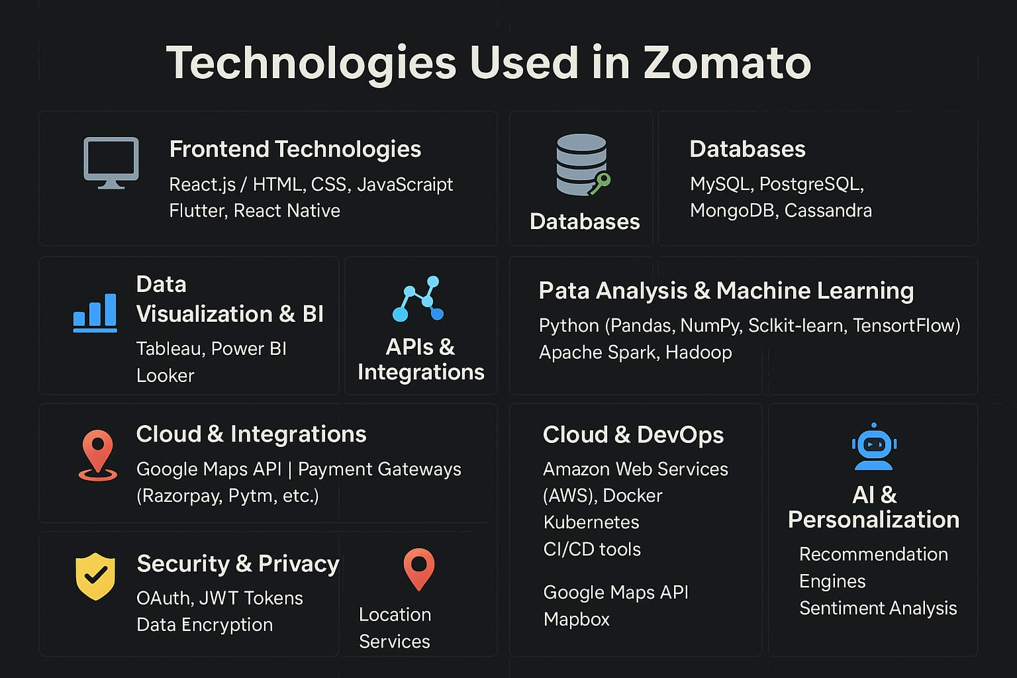
TECHNOLOGIES USED

Slide 6
CUSTOMER BEHAVIOR ANALYSIS
Customer behavior analysis is the process of collecting, analyzing, and interpreting data about customer interactions with a product or service. In the context of Zomato, this involves studying how customers use the platform, what features they engage with, and how they make purchasing decisions.
Why is Customer Behavior Analysis Important?
Improve Customer Experience: By understanding how customers interact with the platform, Zomato can identify areas for improvement and optimize the user experience.
Increase Conversions: By analyzing customer behavior, Zomato can identify the most effective ways to encourage customers to make purchases.
Enhance Customer Retention: By understanding what drives customer loyalty, Zomato can develop strategies to retain customers and prevent churn.
Inform Business Decisions: Customer behavior analysis provides valuable insights that can inform business decisions, such as investments in new features or marketing campaigns.

Slide 7
What Types of Customer Behavior are Analyzed?
Some examples of customer behavior that may be analyzed in the context of Zomato include:
Search and Browsing Behavior: How customers search for restaurants, filter results, and browse menus.
Purchasing Behavior: How customers make purchasing decisions, including what factors influence their choices.
Rating and Review Behavior: How customers rate and review restaurants, and what drives them to leave feedback.
Navigation and Engagement: How customers navigate the platform, and what features they engage with.
How is Customer Behavior Analysis Conducted?
Customer behavior analysis may involve a range of methods, including:
Web Analytics Tools: Tools like Google Analytics provide insights into customer behavior on the Zomato website and mobile app.
Surveys and Feedback Forms: Surveys and feedback forms can provide qualitative insights into customer behavior and preferences.
A/B Testing: A/B testing involves comparing different versions of a feature or interface to determine which one performs better.
Machine Learning Algorithms: Machine learning algorithms can be applied to customer behavior data to identify patterns and predict future behavior.

Slide 8

restaurant performance analysis
Restaurant performance analysis is the process of reviewing key metrics to understand how well a restaurant is doing. It helps in improving services, identifying customer trends, and boosting profitability.
Key factors analyzed:
Sales & Revenue
Order Volume
Customer Ratings
Popular Dishes
Delivery Time
Return Customers

Slide 9
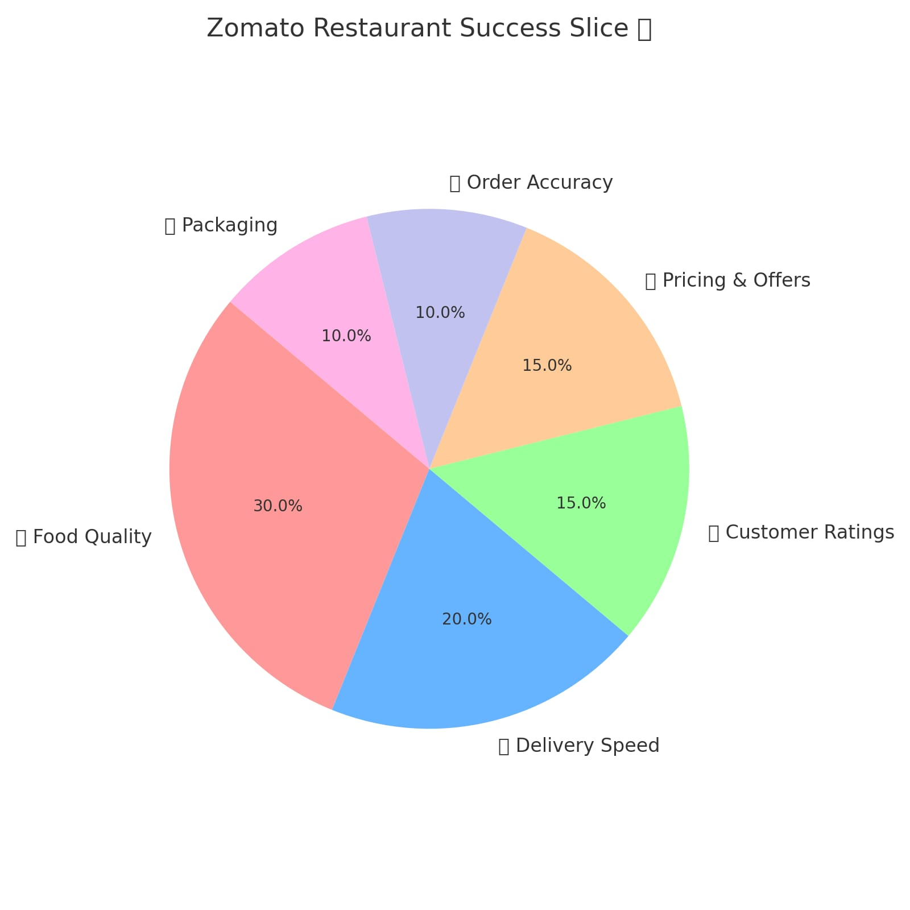

Slide 10
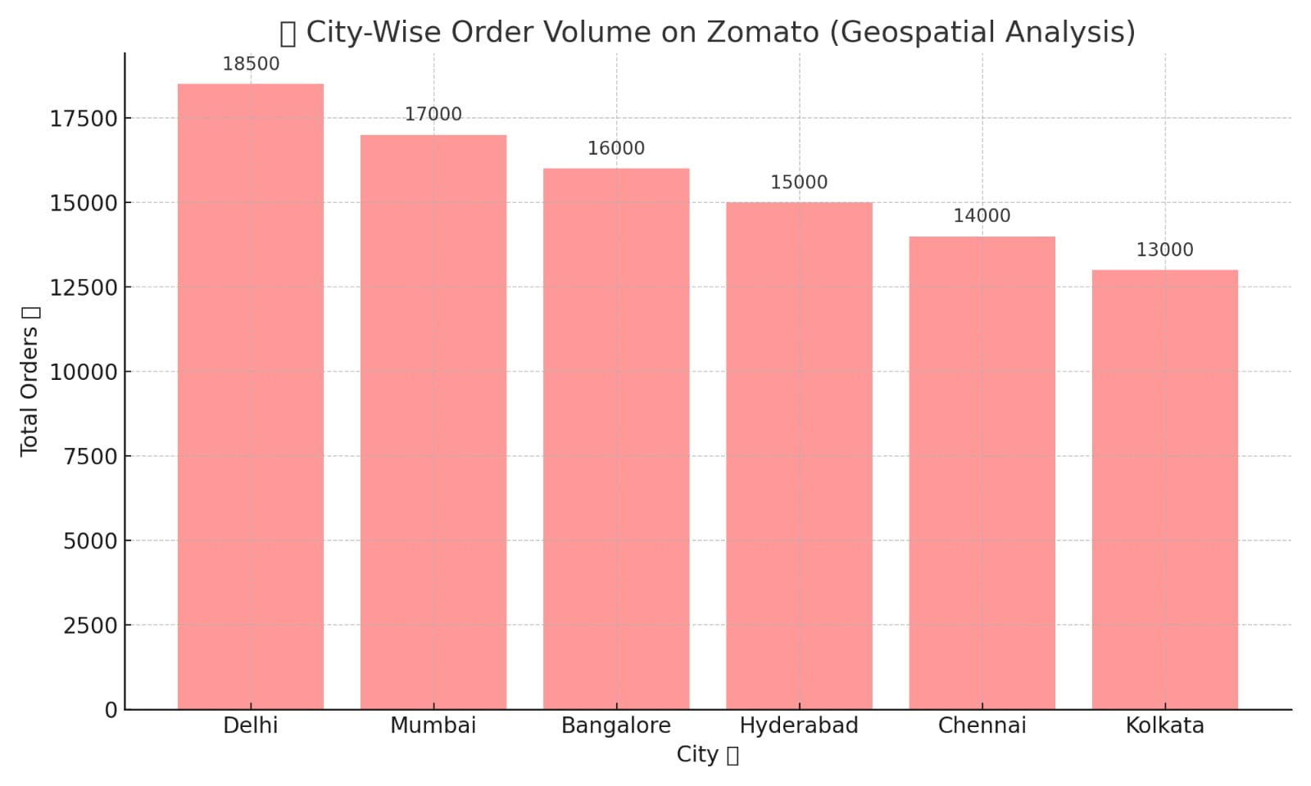
geospatial analysis
What is Geospatial Data Analysis?
Geospatial data analysis involves studying data that has location-based components, like latitude, longitude, city, or area names. It helps Zomato understand where things are happening.

Slide 11

predictive data analysis
Predictive analysis uses historical data + machine learning + statistical algorithms to predict future outcomes. In Zomato, it helps improve customer experience, optimize restaurant operations, and drive business decisions.
Applications of Predictive Analysis in Zomato:
1. Order Volume Prediction
Analyzes time, day, location, and season.
Example: Predicts a surge in pizza orders on weekends or during IPL matches.
2. Delivery Time Forecasting
Uses traffic data, weather, and distance to estimate accurate delivery time.
Helps in auto-assigning delivery partners more efficiently.
3. Customer Churn Prediction
Identifies users who may stop using the app.
Personalized offers or notifications are sent to retain them.

Slide 12
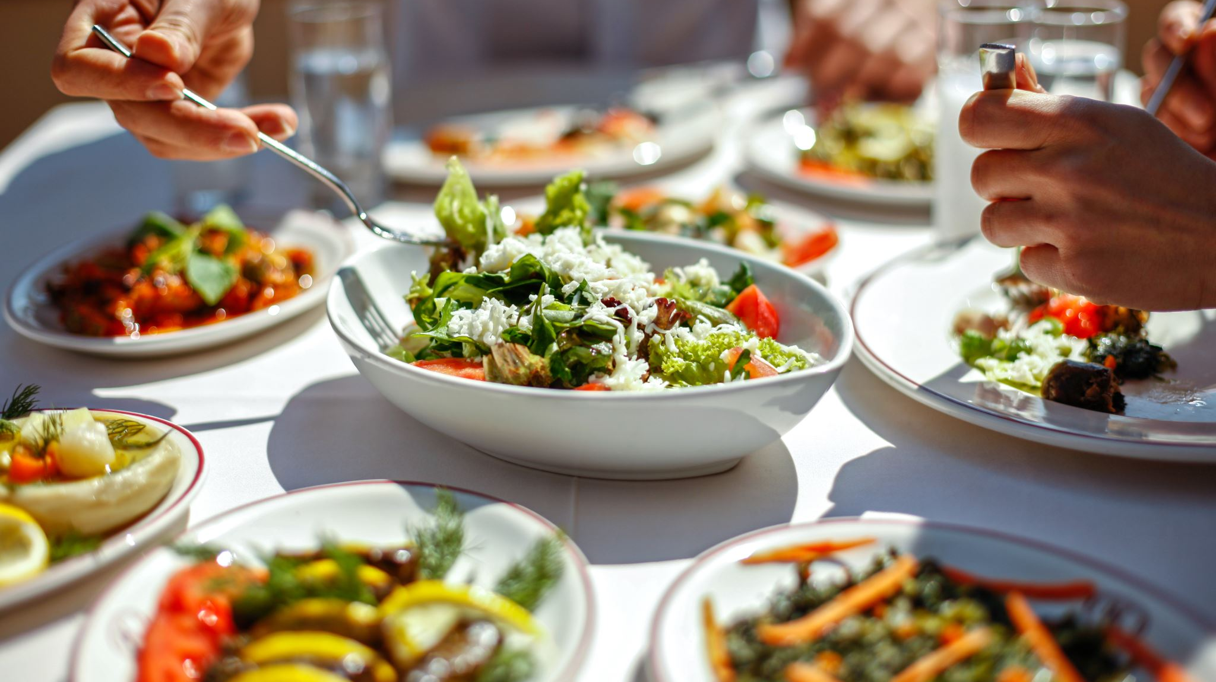
4. Demand Forecasting for Restaurants
Restaurants can prepare staffing and inventory based on predicted demand.
Helps reduce food waste and improve service.
5. Location-Based Trend Prediction
Predicts popular dishes or cuisines in a specific area.
Helps Zomato suggest new outlets or special promotions.
6. Personalized Recommendation System
Based on past orders, ratings, and time of day.

Slide 13
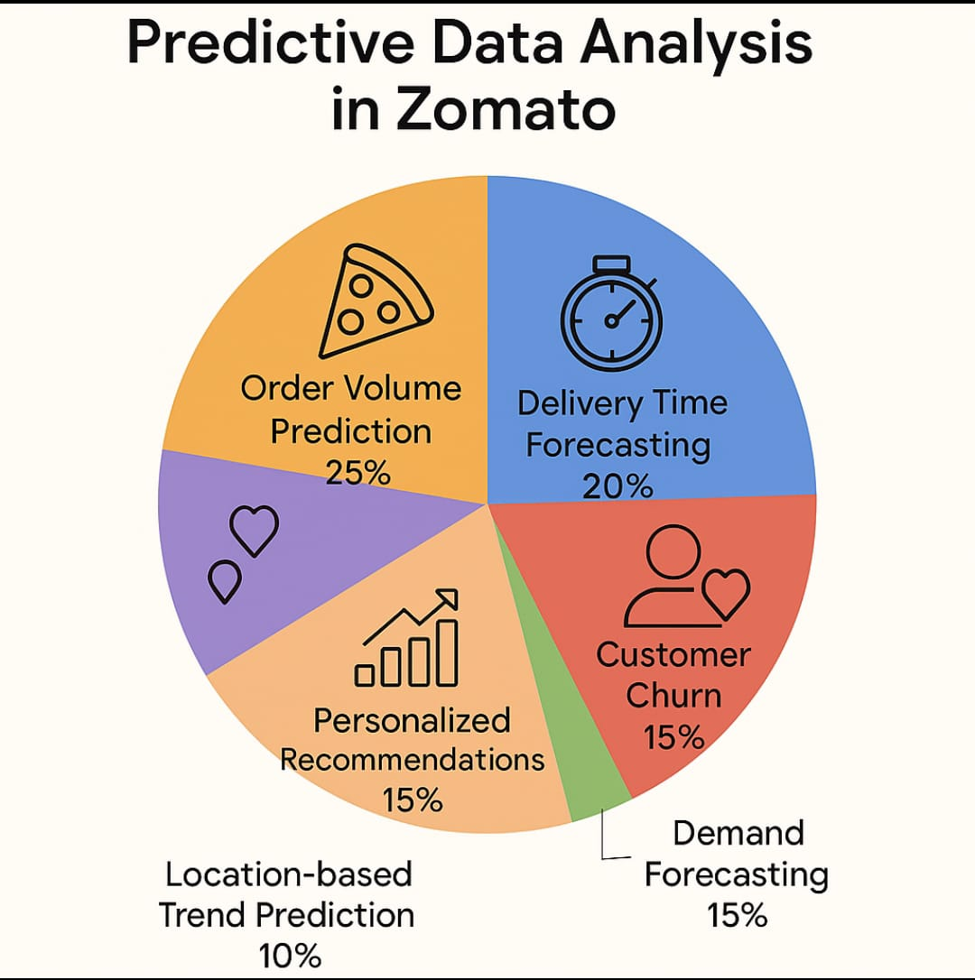

Slide 14
CONCLUSION AND RECOMMENDATION
Conclusion of Zomato Data Analysis
After analyzing Zomato’s customer behavior, restaurant performance, geospatial trends, and predictive models, we conclude:
Customer Patterns are Predictable
Time-based, age-wise, and location-based ordering behaviors are clearly identifiable.
Peak order times are usually evenings and weekends.
Restaurant Performance Varies by Location & Cuisine
Top-performing outlets offer fast service, accurate listings, and better reviews.
Regional preferences influence cuisine popularity.
Personalization Drives Engagement
Personalized recommendations and discounts based on past orders significantly increase customer retention.
Predictive Analysis is Effective
Delivery time, order volume, and customer churn can be predicted with high accuracy using ML models.

Slide 15

Recommendations
1. Enhance Predictive Algorithms
Use real-time data (traffic, weather, events) to refine delivery predictions.
2. Boost Regional Curation
Promote local favorite dishes in specific cities (e.g., Biryani in Hyderabad, Chhole Bhature in Delhi).
3. Dynamic Pricing & Offers
Implement AI-driven offers based on user behavior and order frequency.
4. Restaurant Onboarding & Training
Help restaurants with data-driven insights on how to improve ratings and reduce delivery time.
5. Geo-Based Marketing
Use geospatial analysis to target ads/offers in high-order-density areas.

Slide 16

thank you

